Slide 1
The Pre-Veterinary Medical Association
Welcome to our first meeting!
Dobo 132
7pm

Slide 2
Meet the new Executive Board!
From Left to Right:
Jessica Tillett- Fun & Pub
Chelsea Stowe- Secretary
Ashley Myers- Treasurer
Lauren Shelton- Fun & Pub
Bianca Maletesta- Fun & Pub
Kristen Eagan- Vice President
Laurie LeMonds- President

Slide 3
Advisors
Dr. G. Robert Weedon
Practicing Veterinarian at College Road Animal Hospital
UNCW Adjunct Faculty
Dr. Ann Pabst
Professor, Pre-Vet Advisor
Assistant Chair & Graduate Coordinator
Dr. Jean McNeil
NHC Animal Control Services Manager

Slide 4
New Hanover County Animal Control Services
Located at
180 Division Drive Wilmington, NC 28401
(near the airport)
You will meet:
Dr. Jean McNeil,
Nancy,
Steven,
Jenny,
Erica,
…and more!

Slide 5
Friends of Felines Spay-A-Thon
Non-Profit organization
Capture and Release program that spays and neuters feral cats in the Wilmington area
Monthly; Sundays from 9 am to noon

Slide 6
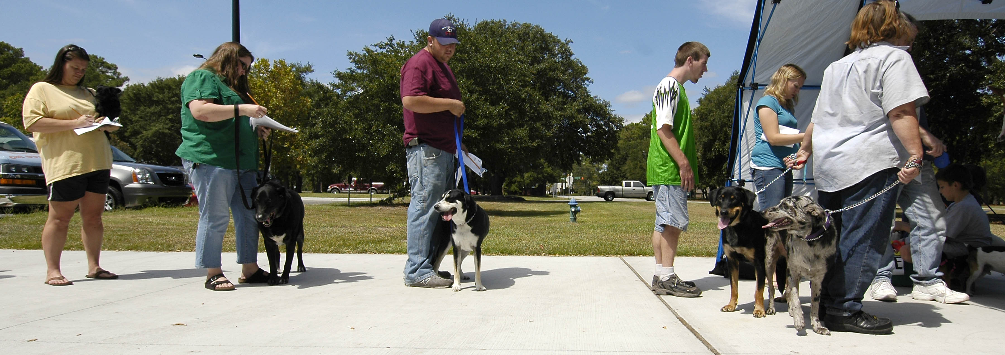
Rabies Clinics
Held Monthly
Locations include:
UNCW Campus
NHC Animal Control Services
Local Parks

Slide 7
T-Shirts
Prices: $5 for Members
$10 for Non-Members

Slide 8
Rabies Awareness Education

Slide 9
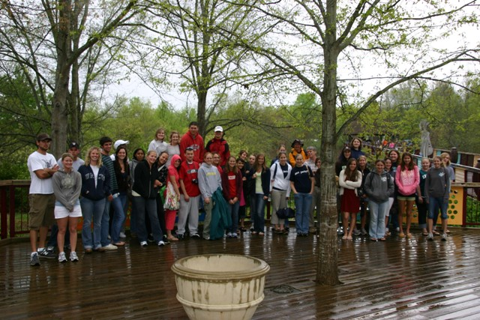
PVMA Events

Slide 10
Dates
August
27th- First Monthly Meeting
31st- FOF Spay-A-Thon (CRAH)
September
3rd- Involvement Carnival (UNCW)
22nd- Meeting (Guest speaker Dr. Richardson from Kansas State)
27th-WRD Rabies Clinic (UNCW)
October
6th & 7th- Fall Break!!
21st- Monthly Meeting (Dobo 103)
November
19th- Monthly Meeting (Dobo 132)
26th thru 28th- Thanksgiving Break!
Note: Dues of $15 ($20 after October’s meeting)

Slide 11
New Looks…
Website:
Facebook Group:
UNCW PVMA
Facebook PVMA Page
…any feedback is welcome!

