Slide 1
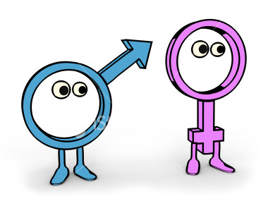
UNCW Goes On A Gender Bender
Presented by Amnesty International

Slide 2
A gender role is a theoretical construct in the social sciences and humanities that refers to a set of social and behavioral norms that, within a specific culture, are widely considered to be socially appropriate for individuals of a specific gender.

Slide 3
Gender identity refers to the options available to members of a society to choose from a set of social identities, based on the combination of one's sex identity on the one hand, and one's natural gender, interests and social experiences on the other

Slide 4
Did you know?
Some ancient tribes have more than five human genders
Most non-Western societies have three human genders -- man, woman and third gender
In the West, gender is considered to be an invalid concept, and is considered to be the same as one's sex identity, for which there are considered only two valid options -- male or female

Slide 5
Patricia B. Campbell, Ph.D. Jennifer N. Storo
“As educators, and as people, we tend to assume that females and males are
different — are indeed “opposite sexes.” We see someone’s sex as an important
predictor of their abilities and interests and assume that if we know someone
is a girl or a boy, we know a lot about them.”

Slide 6
Patricia B. Campbell, Ph.D. Jennifer N. Storo
“That assumption is wrong! Knowing someone’s sex may tell us a lot about them
biologically but it tells us very little about them in other ways. Knowing someone is
a woman does not tell us if her athletic ability is closer to Martina Navratilova’s or
a couch potato's. Knowing someone is a man tells us nothing about whether his
math skills reflect those of an Einstein or a math phobic.”

Slide 7
Martina Navratilova

Slide 8
Do You Like to Shop?

Slide 9
Did you know?
Men change their minds two to three times more often than women. Most women take longer to make a decision than men do, but once they make a decision they are more likely to stick to it.

Slide 10
Can You Change A Tire?

Slide 11
Do You Enjoy Watching Sports?

Slide 12
“Guys don’t bake”

Slide 13
Do You Like To Cook/Bake?

Slide 14
Did you know?
A Saudi Arabian woman can get a divorce if her husband doesn’t give her coffee

Slide 15
Do You Work Out Frequently?

Slide 16
Is Your Major in the Science/Business Field?

Slide 17
Did you know?
Women's representation in computer and information sciences workforce is around 30% globally
In Japan and Peru women are more active in starting a business than men

Slide 18
Is your Best Friend Male or Female?

Slide 19
-Linda Sapadin, a psychologist in Valley Stream, New York
"The belief that men and women can't be friends comes from another era in which women were at home and men were in the workplace, and the only way they could get together was for romance"

Slide 20
-Don O'Meara, Ph.D., at the University of Cincinnati-Raymond Walters College
"People don't know what feelings are appropriate toward the opposite sex, unless they're what our culture defines as appropriate"

Slide 21
Do You Want Children?

Slide 22
Did you know?
Approximately 84% of custodial parents are mothers, and 16% of custodial parents are fathers

Slide 23
Can You Tie A Neck Tie?

Slide 24
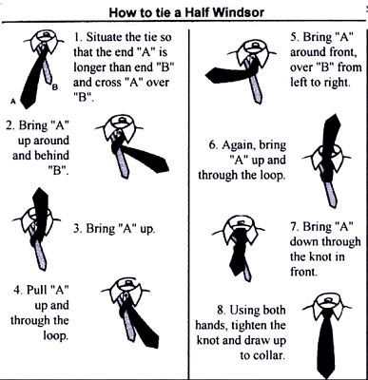

Slide 25
Can You Sew?

Slide 26
Do You Have Long Hair?

Slide 28
Do You Play a Sport?

Slide 29
Patricia B. Campbell, Ph.D. Jennifer N. Storo
“It is a common belief that because men are the principal producers in “modern” society that this has always been the case. In fact in earlier times when women were the main food-gatherers and producers, there were matriarchal societies where women had high status, were preeminent as cultivators and were glorified as goddesses. As late as the 2nd century BC, the major deities in European culture were women.”

Slide 31
